Slide 1
Classification of Programming Languages

Slide 2
Introduction
To build programs, people use languages that are similar to human language.
A programming language consists of all the symbols, characters and usage rules that permit people to communicate with computer.
Programming languages fall into three broad categories:
  Machine language
  Assembly language
  High level language

Slide 3
Machine Language
The language in which binary code is used to write a program is known as machine language.
Explicit instructions are to be given to the machine to perform every operation.
An instruction prepared in the machine language will have at least two parts: Op-code and Operand.
Different types of hardware use different machine code.
For example, IBM computers use different machine language than Apple computers.

Slide 4
Continue…
Advantages:
  execution very fast by the computer
  make efficient use of storage
Disadvantages
  writing program is tedious, time consuming and highly error-prone.
  requires a high level of programming skill
  machine dependent
  difficult to correct or modify program

Slide 5
Assembly Language
Assembly languages (second-generation languages) are only somewhat easier to work with than machine languages.
To create programs in assembly language, developers use cryptic English-like phrases to represent strings of numbers.
The code is then translated into object code, using a translator called an assembler.

Slide 6
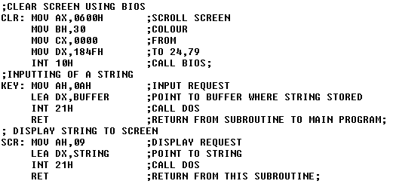
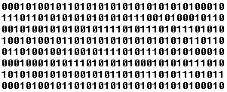
Continue…
Assembly
code
Assembler
Object code

Slide 7
Continue…
Advantages
- mnemonics are easier to remember
- not required to keep the track of memory locations (use of variable)
- easier to modify
- required less human effort to write program
Disadvantages
- machine dependent
- coding is time consuming

Slide 8
High Level Language
Higher-level languages are more powerful than assembly language and allow the programmer to work in a more English-like environment.
Higher-level programming languages are divided into three "generations," each more powerful than the last:
  Third-generation languages
  Fourth-generation languages
  Fifth-generation languages

Slide 9
Third Generation language
Third-generation languages (3GLs) are the first to use true English-like phrasing, making them easier to use than previous languages.
3GLs are portable, meaning the object code created for one type of system can be translated for use on a different type of system.
The following languages are 3GLs:
  FORTAN C
  COBOL C++
  BASIC Java
  Pascal ActiveX

Slide 10
Fourth Generation Language
Fourth-generation languages (4GLs) are even easier to use than 3GLs.
4GLs may use a text-based environment (like a 3GL) or may allow the programmer to work in a visual environment, using graphical tools.
The following languages are 4GLs:
  Visual Basic (VB)
  VisualAge
  VB .Net

Slide 11
Fifth Generation Language
Fifth-generation languages (5GLs) are an issue of debate in the programming community – some programmers cannot agree that they even exist.
These high-level languages would use artificial intelligence to create software, making 5GLs extremely difficult to develop.
Solve problems using constraints rather than algorithms, used in Artificial Intelligence
-Prolog

Slide 12
High level language
Advantages
- machine independent
- easier to learn
- require less time to write program
- does not require the knowledge of the internal structure of a computer
- provide better documentation
- easier to maintain
- modification is easy and straight

Slide 13
Continue…
Disadvantages
- Lower efficiency: as need compiler which is loaded into the main memory of the computer, take more time to run
- Lack of flexibility: as many things are automatic and are not under the control of programmer, it is less flexible

Slide 14
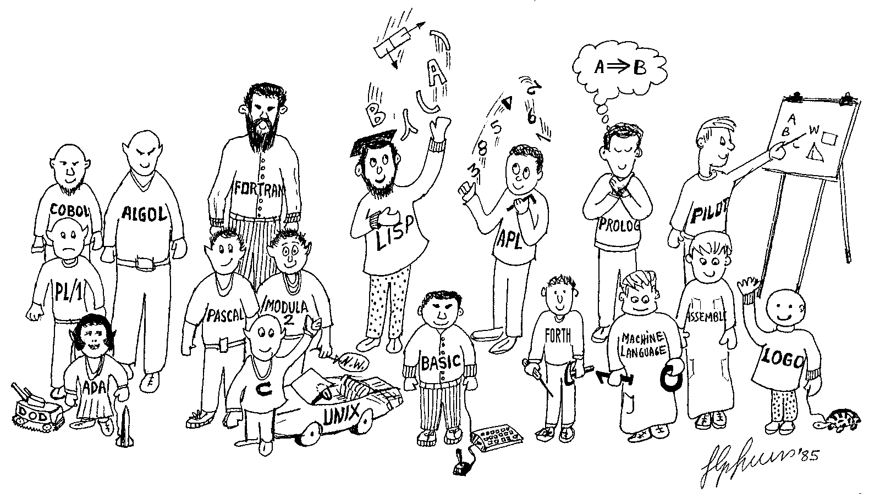

Slide 15

Translator

Slide 16
Continue…
Translator is a computer program that performs the task of converting a program written in one programming language into a program in another programming
Compiler: Compiler is a translator that accepts instructions written in high level language and converts each instruction into machine language producing a complete program in machine language known as object program.
- Ex: Pascal, C, Fortran use compiler

Slide 17
Continue…
Interpreter: Interpreter is a kind of translator that translates and executes each source language statement written in high level language before translating and executing next one but does not produce a object program.
- Ex:BASIC, PROLOG, LISP use interpreter
Assembler: Assembler is a translator that converts assembly language written program into the machine language program.

Slide 18
Compiler Vs Interpreter
Interpreter | Compiler
Translates line by line | Translates the entire program at a time
Requires less main memory | Requires more main memory
Each time program is executed, every line is converted to equivalent machine code | Converts the entire program to machine code and executes the object code directly
Source program and interpreter are required for execution | Source and compiler are not required for execution
Execution time is more | Execution time is less

Slide 19
Process of Compilation
The major steps involved in compilation process are:
  Lexical analysis
  Syntax analysis
  Code generation
Lexical analysis: This phase reads the source program and separate all characters of the source program into meaningful groups called the tokens.
- The tokens are identifiers, operators, keywords, punctuation symbols

Slide 20
Continue…
Syntax analysis: The syntax analysis of a source program performed by the compiler ascertain whether the grammatical rules of the language have been followed or not.
- If these rules have been followed correctly then the source program is converted into machine language and loaded into main memory of the computer for execution.
Code generation: produces the appropriate machine language statements from the structures produced by the syntax analyzer. It involves:
- allocation of memory space for the data items
- generation of machine language instructions

Slide 21
Debugging
The process of location and removal of errors is called debugging.
The errors present in a source program are in general of three types:
- Syntax errors
- Execution errors
- Logical error
Syntax errors: These errors due to the violation of the rules (syntax) of the language.
- incorrect punctuations, invalid symbolic names, misspelled keywords, illegal statements

Slide 22
Continue…
Execution/run-time errors: Errors that allow execution to begin but cause it to terminate prematurely or producing wrong results.
- detected during execution of the program and it includes:
  attempt to divide by zero
  infinite loops
  square root of negative number
  using an array that exceeds the space reserved for it.

Slide 23
Continue…
Logical errors: It arise from faulty programming logic.
  Are difficult to locate
  Can be detected by going through the flow chart and by running programs on some sample data

Slide 24
Thank You!

